Slide 1
Sampling Distributions of Sample Proportions

Slide 2
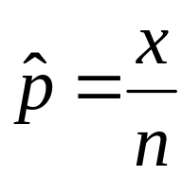

Sample Proportion
Suppose that a random sample of size n is obtained from a population in which each individual either does or does not have a certain characteristic. The sample proportion, denoted (read “p-hat”) is given by
where x is the number of individuals in the sample with the specified characteristic. The sample proportion is a statistic that estimates the population proportion, p.

Slide 3
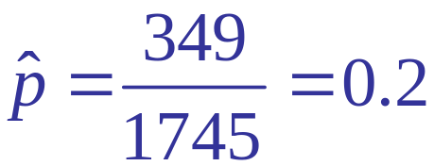
Example 1: Counting a sample proportion
In a Quinnipiac University Poll conducted in May of 2008, 1745 registered voters nationwide were asked whether they approved of the way George W. Bush is handling the economy. 349 responded “yes”. Obtain a point estimate for the proportion of registered voters who approve of the way George W. Bush is handling the economy.

Slide 4
Example 2: Constructing Sampling Distribution of Proportion

Slide 5






Suppose we have a population of six people: Alice, Ben, Charles, Dennies, Edward, & Frank
What is the proportion of females?
What is the parameter of interest in this population?
Draw samples of two from this population.
How many different samples are possible?
1/3
Proportion of females
₆C₂ =15

Slide 6
Find the 15 different samples that are possible & find the sample proportion of the number of females in each sample.
Alice & Ben .5
Alice & Charles .5
Alice & Denise 1
Alice & Edward .5
Alice & Frank .5
Ben & Charles 0
Ben & Denise .5
Ben & Edward 0
Ben & Frank 0
Charles & Denise .5
Charles & Edward 0
Charles & Frank 0
Denise & Edward .5
Denise & Frank .5
Edward & Frank 0

Slide 7
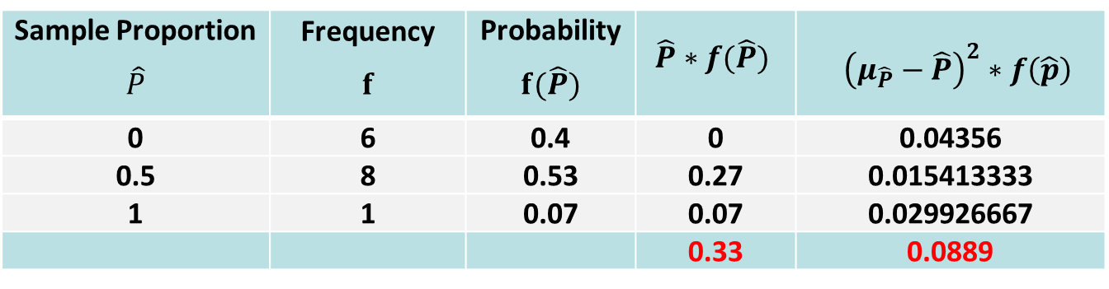

Sampling Distribution of Sample Proportions

Slide 8

Properties

Slide 9
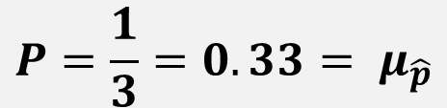
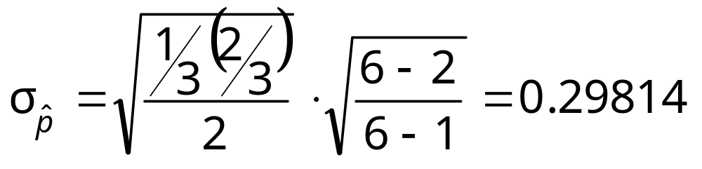
Properties…

Slide 10

Central Limit Theorem

Slide 11
Example 3: Finding Probabilities

Slide 12
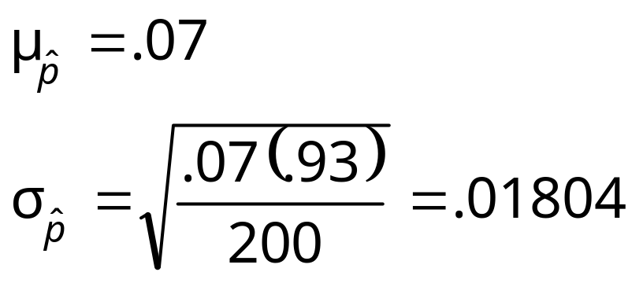
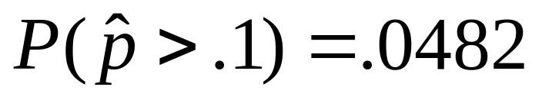
Based on past experience, a bank believes that 7% of the people who receive loans will not make payments on time. The bank recently approved 200 loans.
What are the mean and standard deviation of the proportion of clients in this group who may not make payments on time?
Are assumptions met?
What is the probability that over 10% of these clients will not make payments on time?

Slide 13
Example 4: Finding Probabilities

Slide 14

Assume that 30% of the students at HH wear contacts. In a sample of 100 students, what is the probability that more than 35% of them wear contacts?

Slide 15
Example 5: Finding Probabilities

Slide 16
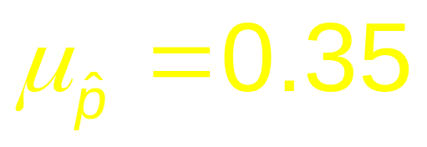
We have drawn an SRS of size 1500 from the population of interest.
The mean of the sampling distribution of p-hat is 0.35:

Slide 17

We want to know the probability that a random sample yields a result within 2 percentage points of the true proportion.
We want to determine

Slide 18
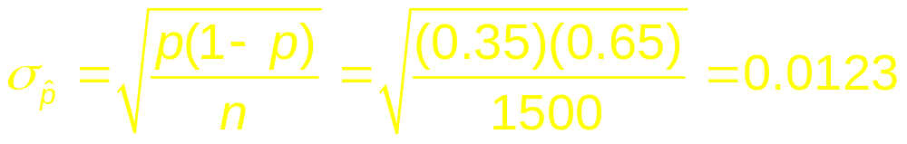
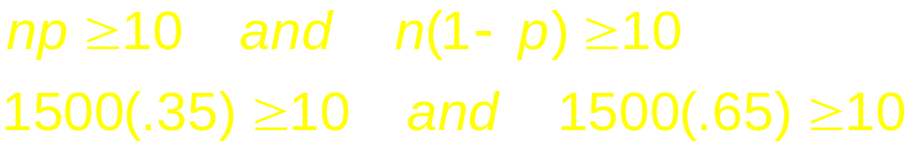

We can assume that the population of first-year college students is over 15,000, and are safe to use the standard deviation formula:
In order to use a normal approximation for the sampling distribution, the expected number of successes and failures must be sufficiently large:
Therefore,

Slide 19

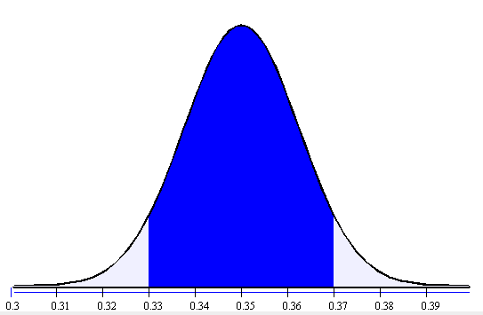
Perform a normal distribution calculation to find the desired probability:

Slide 20
CONCLUDE: About 90% of all SRS’s of size 1500 will give a result within 2 percentage points of true proportion.

